Slide 1
Customer Lifetime Value:
Modeling Customer Profile for Underwriting Optimization
Brisa H, Njenga G, Rashmi K

Slide 2
Introduction
Predict Customer Lifetime Value (CLV) using customer profile data
Assess profitability of prospective insurance customers
Determine whether predicted CLV meets the required profitability threshold
Identify features that strongly influence CLV

Slide 3
Dataset Overview
IBM Watson Marketing Customer Value dataset (Kaggle)
Type: Structured Customer level insurance data
9,134 customers, 24 variables
It is a mix of demographic, behavioral, policy and vehicle characteristics
Categorical variables: State, Coverage type, Education level, Employment Status Gender, Location Code, Marital Status, Policy Type, Vehicle Class, and Vehicle Size
Numerical variables: Income, Monthly Premium, Number of Policies, Total Claim Amount, and Months Since Last Claim
Single CSV file: no merging, No Missing values: no imputation
No Privacy concerns

Slide 4
Exploratory Data Analysis (EDA)
Analyzed Categorical columns-Proportion of CLV against each category
Numerical statistics of Average CLV against each category
Explored the distributions of the numerical columns
Box plots of our numerical data to view outlier
Analyzing Relationships Between Variables using Pairplots
Identifying Interactions

Slide 5
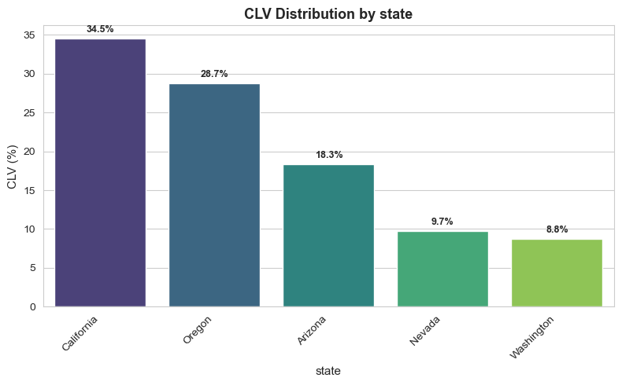
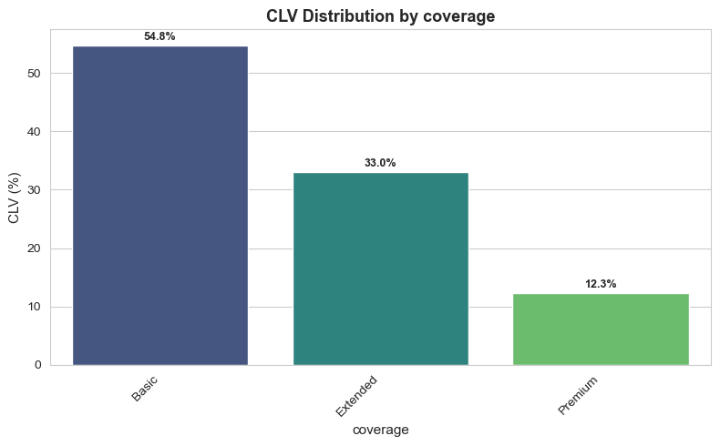
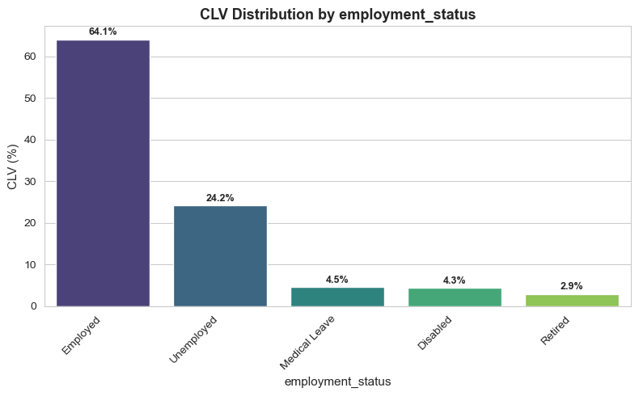
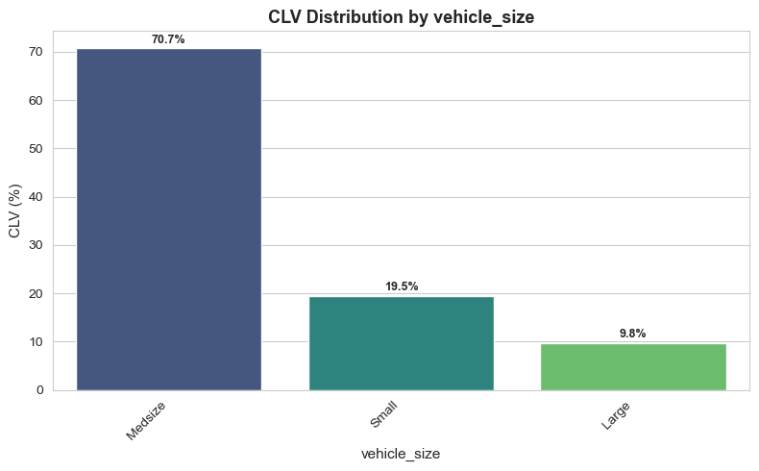
Various category labels vs proportion of CLV

Slide 6
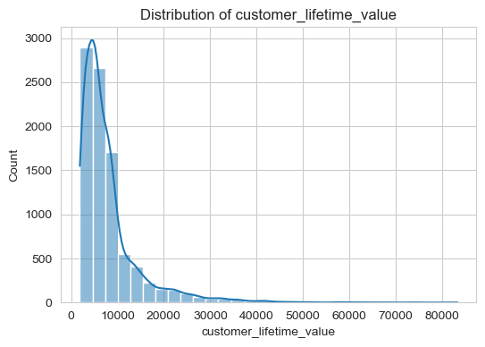
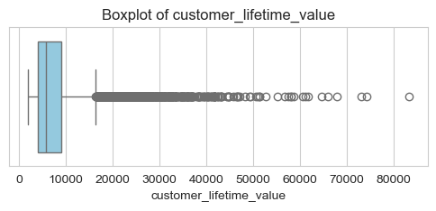
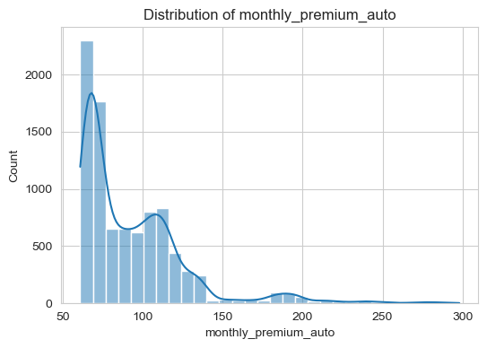
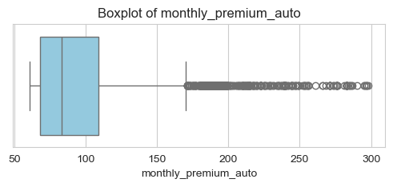
Distributions of the numerical columns

Slide 7
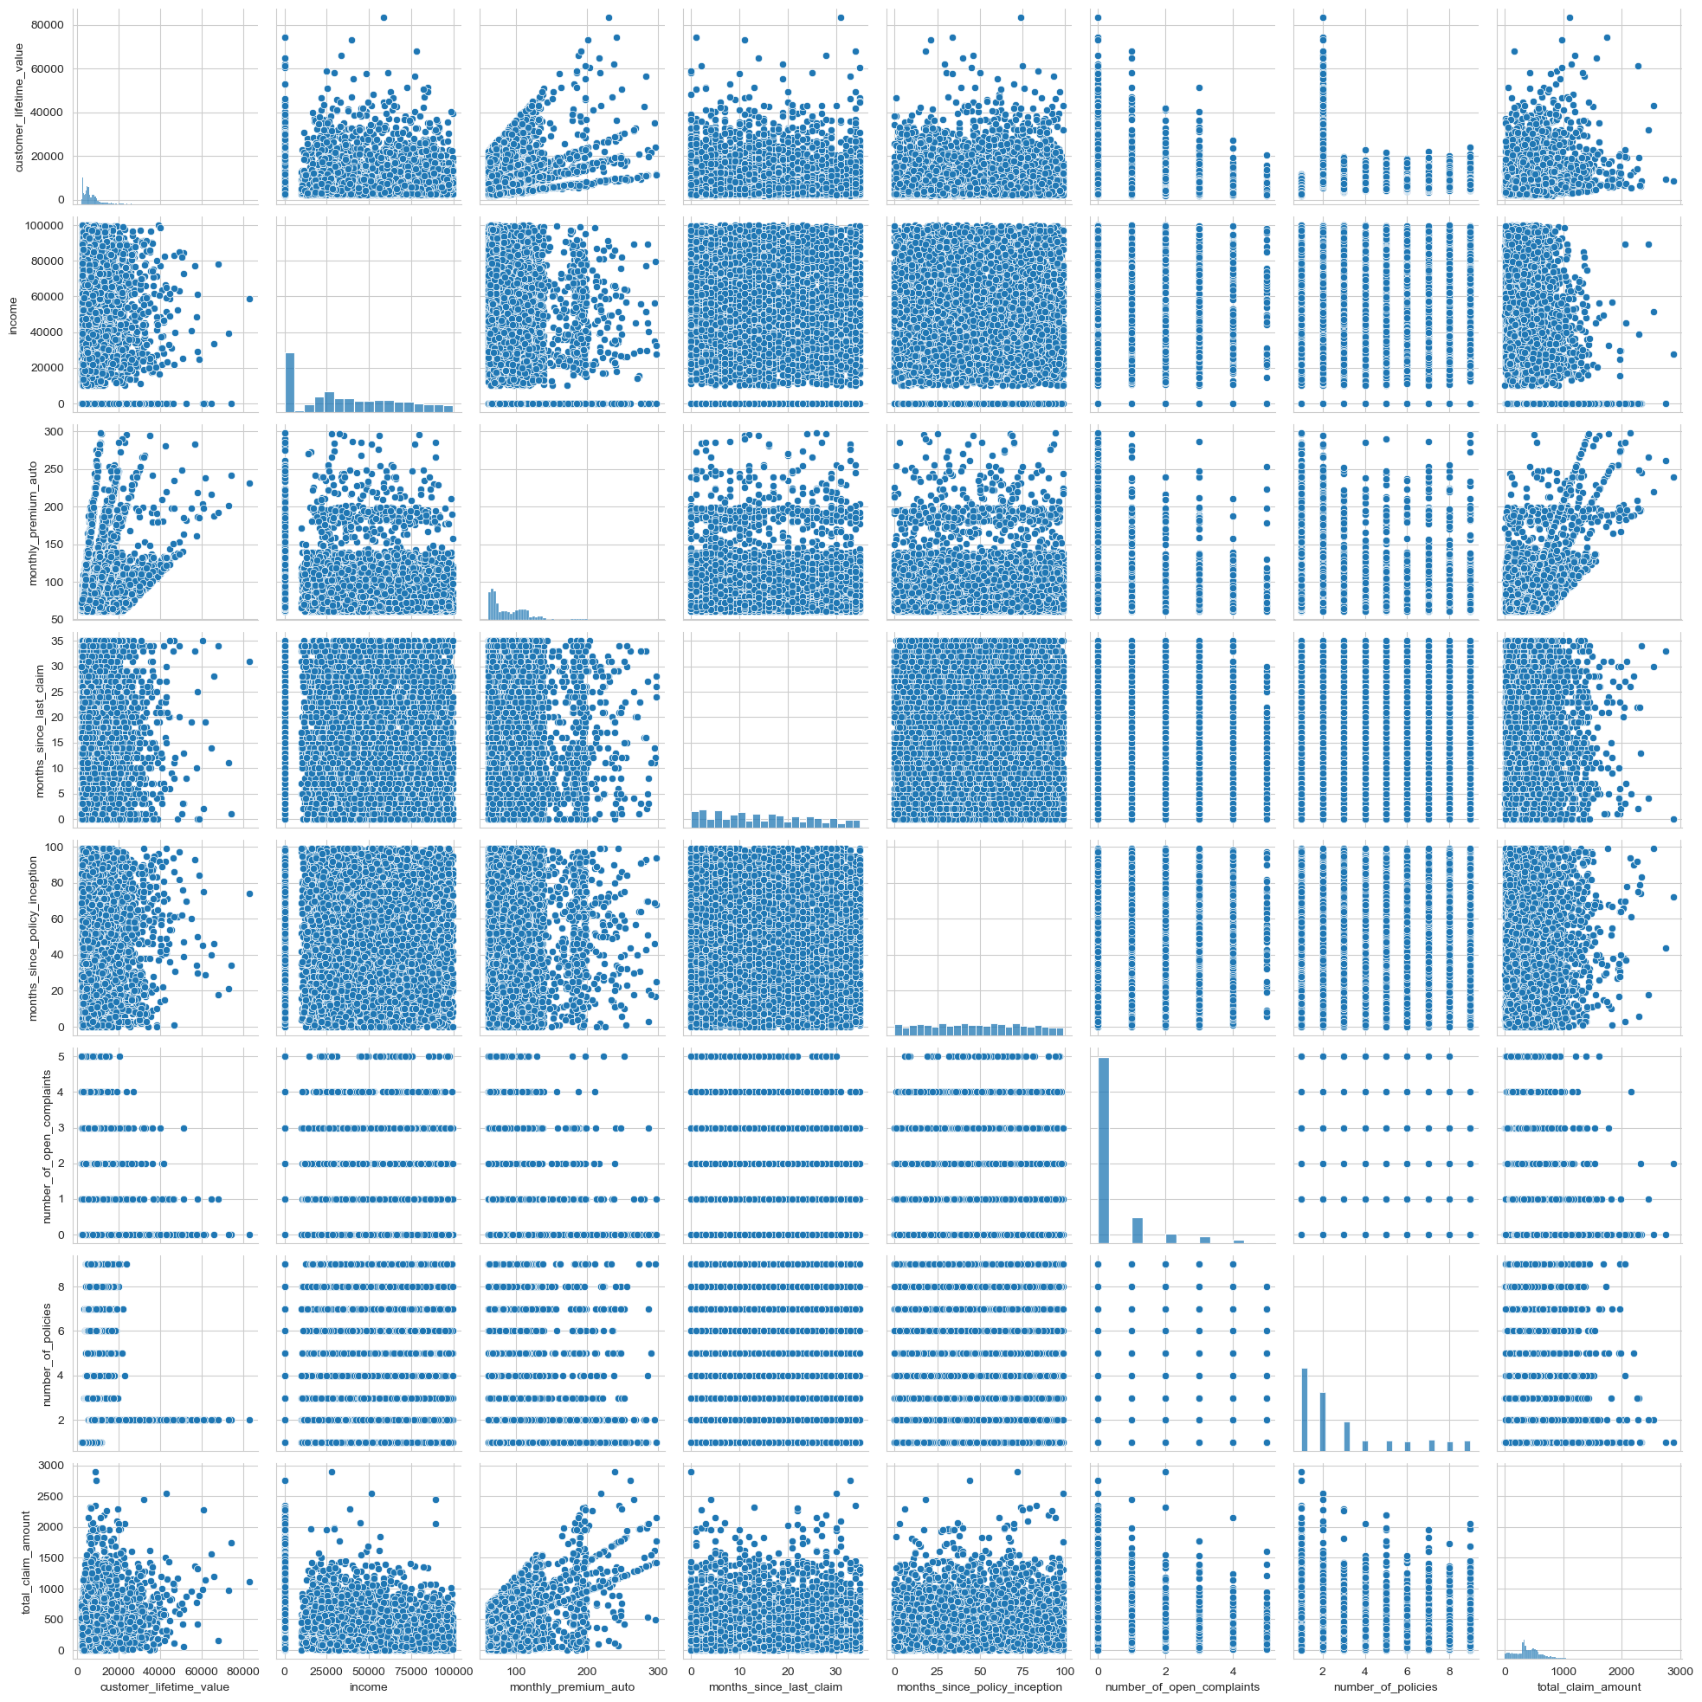
Analyzing Relationships Between Variables

Slide 8
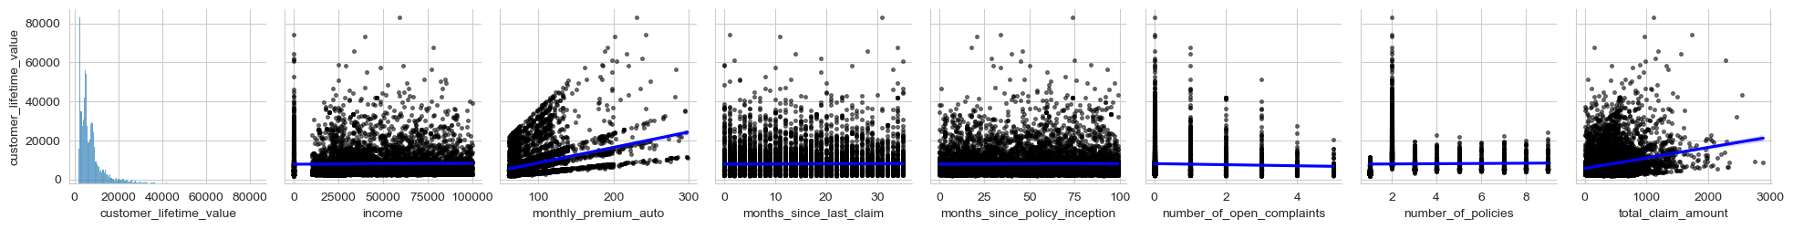
“Striped” pattern : CLV Vs monthly premium.

Slide 9
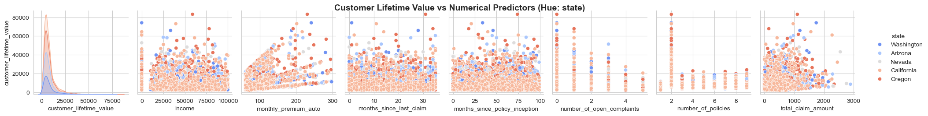
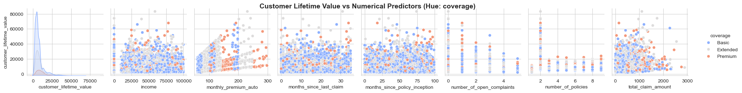
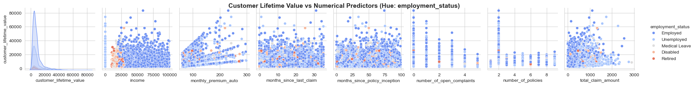
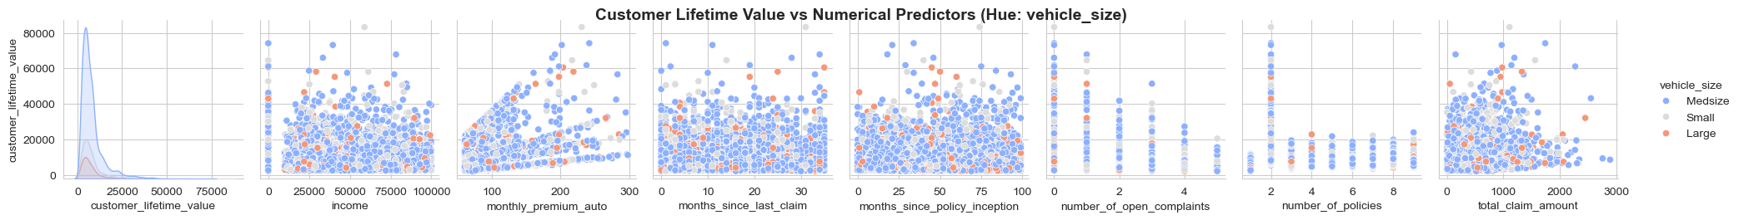
Relationships with categorical data as hue

Slide 10
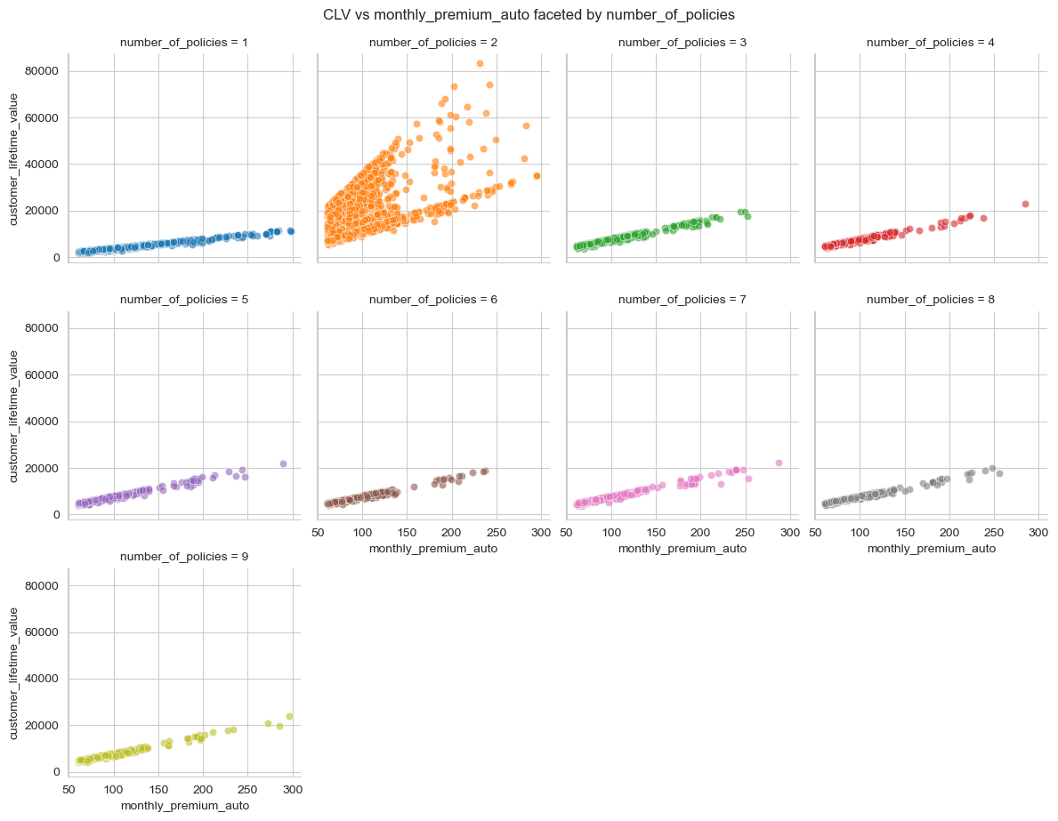
Unusual Pattern when number of policy is 2

Slide 11
Key Finding : Two-Policy Customers
Irregular and difficult to interpret trends
Did not follow patterns of other policy groups
Handled separately in modeling to improve performance

Slide 12
Modeling approach
´ Problem Type
• Supervised Regression
6 Approaches Used
Five Ordinary Least Squares (OLS) regression models
One Random Forest model to capture non-linear patterns
Pre-Processing
Categorical variables converted to binary indicators using one-hot encoding
Numeric predictors kept on original scale since no normalization needed based on EDA.

Slide 13
Modeling approach
Approach 1: Baseline OLS
Built an initial Ordinary Least Squares (OLS) model using all customer features
Used this as our baseline to compare later models
Reviewed R-squared, coefficients, and p-values to see which factors influence CLV
Noticed unusual patterns among customers with exactly two policies, leading us to consider segmentation or alternative modeling approaches
Approach 4: Single Policy OLS
Created nine separate OLS models, each for a specific policy count
Only included statistically significant predictors in each subgroup model to reduce noise

Slide 14
Modeling approach
Approach 6: Random Forest Regressor
Applied a Random Forest Regressor to capture non-linear relationships in CLV
Used train and test split to evaluate generalization using test-set R-squared
Performance was still affected by the two-policy group
Re-trained the model excluding customers with exactly two policies to stabilize predictions

Slide 15
Computation Results
Approaches | Description | R-squared
Approach 1 | OLS regression with all variables | 0.160
Approach 2 | OLS regression omitting policies with CLV above the 75th percentile of 2-Policy customers | 0.247
Approach 3 | OLS with two-policy dummy and interaction term | 0.666
Approach 3a | Reduced OLS model (premium + interaction term) | 0.627
Approach 4 | OLS models by policy count | 1pol: 0.996, 2pol: 0.326, 3pol: 0.995, 4pol: 0.995, 5pol: 0.995, 6pol: 0.994 7pol: 0.993, 8pol: 0.995, 9pol: 0.996
Approach 5 | OLS regression excluding two-policy customers | 0.796
Approach 5a | OLS regression with exactly two-policy customers | 0.340
Approach 6 | Random Forest model excluding two-policy customers | 0.996

Slide 16
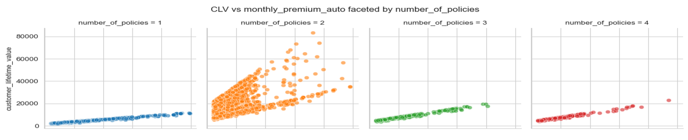
Interpretation – Key Takeaways
Policy count is the strongest driver of model performance, especially the unique behavior of customers with exactly two policies
Approach 1 & 2 (Baseline & 75th percentile OLS approaches)
Did not perform well because they did not explicitly account for policy count
Stratification in monthly premium for two-policy customers remained unaddressed
Approach 3: Interaction Based OLS
Addressed the number of policy directly by adding a binary two-policy flag and an interaction with monthly premium
Captured the “striped pattern” observed in EDA
Improved performance to R² = 0.666, but still limited compared to later models

Slide 17
Interpretation – Key Takeaways
Approach 4: Single Policy OLS
Each policy-count group has its own model; predictions are made using the model for that specific group
Produces extremely high performance for all groups except two policy group
Provides high model explainability, which is valuable in a regulated industry
The improvement from Approach 4 justifies the extra effort when explainability is a key consideration
A simplified version (Approach 5) drops two-policy customers and uses one OLS model, but its R-squared (0.796) is notably lower than the individual models

Slide 18
Interpretation – Key Takeaways
Approach 6: Random Forest Regressor
Random Forest Regressor our highest-performing model when excluding two-policy customers (R-squared = 0.996)
Offers strong predictive power with more convenience , but with reduced explainability
When including all customers, Random Forest achieves only 0.686 R-squared, slightly better than the interaction-based OLS model

Slide 19
Key Challenges and Next Steps
All models struggle specifically with customers who have exactly two policies
No variables in the dataset explain the variation in their premiums or CLV.
Recommendation: collect more data or conduct deeper analysis to understand two-policy customers; for now, use either
Segmented OLS models (Approach 4) or
Random Forest excluding two-policy customers depending on the needed level of explainability

Slide 20
Conclusion
Goal: build a reliable tool to estimate customer CLV from application
Two strong models identified:
  Policy-specific OLS models (high explainability)
  Random Forest without two-policy customers (high accuracy, single model)
Both models can guide decisions on which policies are worth writing
Main limitation: CLV cannot be predicted well for two-policy customers
Further data is needed to understand their unusual premium behavior

Slide 21
Thank You

